Slide 1
Exploration of Efficient End-to-End Acoustic Models for On-device Speech Recognition
Wonyong Sung
School of Electrical and Computer Engineering
Seoul National University

Slide 2
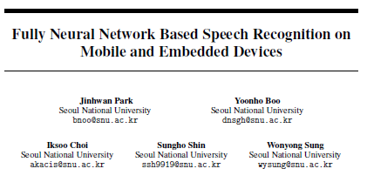
Contents
On-device speech recognition and DRAM bandwidth bottleneck problem
Muti-time step parallel and linear recurrent RNNs
QRNN+1-d time-depth convolution based models
Gated ConvNet and Simple Gated ConvNet based models
Park, Jinhwan, et al. "Fully neural network based speech recognition on mobile and embedded devices." Advances in neural information processing systems. 2018.

Slide 3
Why on-device speech recognition?
Most ASR today is server-based
Speech (or feature extraction on device) → communication channel -> Remote ASR server, exploiting computation efficient GPUs
Problems:
Delay of response, privacy issues
Large cost of server operation (Edge Computing is needed)
On-device speech recognition can be a solution for these problems.
Processing power and battery life issues at devices

Slide 4
Speech Recognition
Speech
samples
Feature
extraction
Words
Decoder
Acoustic
model
Language
model
Lexicon
Frame-level triphone state + WFST based method
End-to-end approaches – easy decoding and large corpus
CTC + RNN LM
Neural transducers
LAS (Listen Attend & Spell)

Slide 5
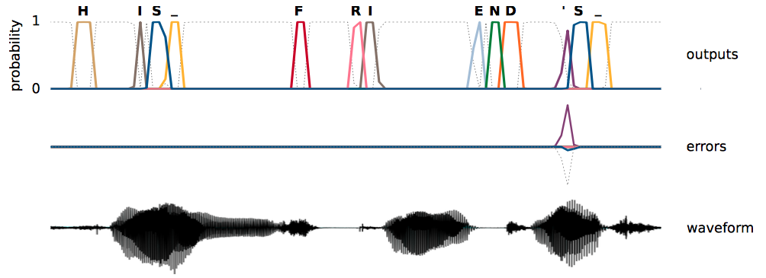
CTC algorithm
Connectionist Temporal Classification
Connectionist Temporal Classification : Labelling Unsegmented Sequence Data with Recurrent Neural Networks, 2006 ICML.
Feature : frame sequence e.g. every 10 msec
Label : text sequence: {a, b, c, : : : , z, space, apostrophe, blank}
To fill the length difference gap between the input and output, employ the blank labels
(Graves and Jaitly, ICML 2014)

Slide 6
CTC algorithm and decoding
CTC is a sequence modeling algorithm
It needs to observe fairly long frames (not a single frame)
LSTM RNN is usually used.
The CTC output can be decoded simply by removing blank and repetition labels, which is so called the greed decoding. But, the output is usually post-processed using a language model.
The language model:
Character-level: the input and output are simple but the performance is lower.
Word-level: the input and output (softmax layer) complexity is proportional to the vocabulary size.
Word-piece model: no OOV, limited complexity

Slide 7
Contents
On-device speech recognition and DRAM bandwidth bottleneck problem
Muti-time step parallel and linear recurrent RNNs
QRNN+1-d time-depth convolution based models
4. Gated ConvNet and Simple Gated ConvNet based models

Slide 8
On-device implementation of RNN acoustic models: Memory bound or Arithmetic bound?
RNN parameter size is 10 million ~ 100 million
The frame rate is usually about 20 msec
How many arithmetic operations?
10M*50*2 (for add, mult) =~ 1 Giga op./sec (~10 Giga)
1GHZ, SIMD arithmetic (128 bit data-path for ARM): 4~16 operations (float, half-precision, 8bit) for one instruction (4~16Gops/sec)
How about DRAM accesses? (Energy consumption?)
Parameters are used only once and larger than cache size (2MB for an ARM CPU)
0.5G ~ 5GByte/sec memory accesses
1DRAM access takes about 50ns for fetching 256bits (32Bytes)
The effective BW is less than 1GB/sec

Slide 9
Memory access bottleneck is not solved by quipping many multiply-adders
Hardware accelerator
Neural network parameters on DRAM

Slide 10
How GPUs solve the memory bottleneck?
Batch processing in GPU – popular batch size of 32~256, and one memory fetch is reused in the batch
On-device speech recognition – the batch size is 1.

Slide 11
Memory bandwidth reduction for on-device neural networks
Model compression
Fixed-point optimization
32bit floating-point -> 8bit fixed-point -> (future 4bit ?) (x4 ~ x8)
Pruning, SVD transformation, and etc.
Reducing the number of non-zero parameters.
It may need decompression HW for non-structured pruning
Parallelization – computing multiple output samples at a time (multi-time-step parallelization)
Usually, parallelization technique was of interests in GPU based computing to utilize large scale hardware
We employ this technique to reduce the memory bandwidth

Slide 12
Contents
On-device speech recognition and DRAM bandwidth bottleneck problem
Muti-time step parallel and linear recurrent RNNs
QRNN+1-d time-depth convolution based models
4. Gated ConvNet and Simple Gated ConvNet based models

Slide 13
Multi time-step parallel processing
We fetch one parameter and use it for multiple (B) inferences (time-steps), and the number of DRAM access becomes inversely proportional to B
Multi-time-step parallel processing is obvious for feed-forward neural networks (fully connected DNNs, CNNs)
one weight fetch
Neural Network
W
h0, h1, h2, h3, …
x0, x1, x2, x3, …

Slide 14
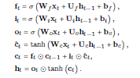
Multi time-step parallel processing for LSTM RNN
LSTM RNN is most widely used for end-to-end acoustic modeling
Single thread LSTM RNN and GRU do not permit multi time-step processing because of the dependency problem. We need to compute the output one by one, sequentially.
Non-linear
dependency

Slide 15
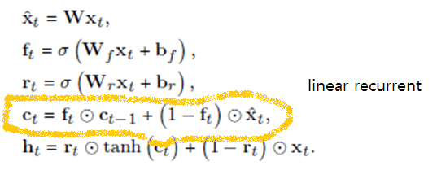
Neural networks supporting multi-time-step parallelization
Linear recurrent RNNs (no U matrices)
QRNNs (Quasi-RNN)
SRU (Simple Recurrent Unit)
No dependency on h_{t-1}

Slide 16
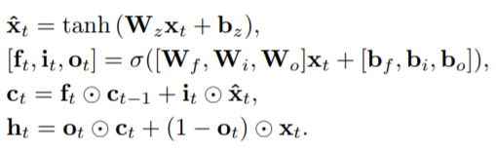
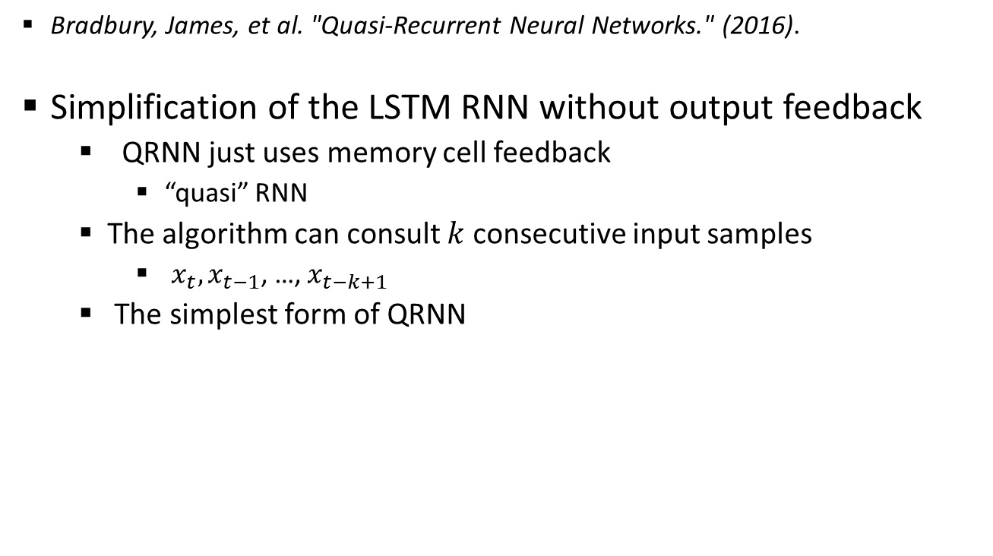
The quasi RNN (QRNN)
Bradbury, James, et al. "Quasi-Recurrent Neural Networks." (2016).
Simplification of the LSTM RNN without output feedback
QRNN just uses memory cell feedback
“quasi” RNN
The algorithm can consult $k$ consecutive input samples
$x_{t}, x_{t−1}$, …, $x_{t−k+1}$
The simplest form of QRNN
Notes:
1 분

Slide 17
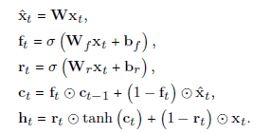
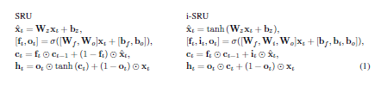
Linear recurrent neural networks
QRNN:
SRU

Slide 18
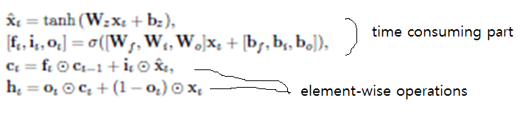

SRU computation with BLAS
x_{t}^, f_{t}, r_{t}: 3 matrix-vector mul. (3N² operations)
c_{t}, h_{t}: Vector operations (4 N operations)
The matrix-vector multiplication becomes matrix-matrix multiplications (BLAS can used)

Slide 19
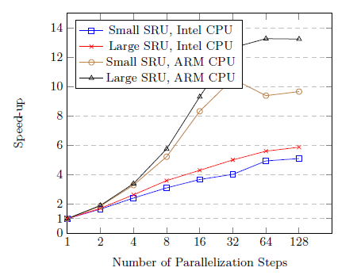
Speed-up on Intel and ARM CPU
Larger speed-up is achieved in ARM CPU (poorer memory system)
Large SRU width 1024, small SRU with 512

Slide 20
Contents
On-device speech recognition and DRAM bandwidth bottleneck problem
Muti-time step parallel and linear recurrent RNNs
QRNN+1-d time-depth convolution based models
4. Gated ConvNet and Simple Gated ConvNet based models

Slide 21
Performance (accuracy) issues
CTC is a sequence recognition algorithm, and it needs to observe a long span of time
RNN is favored
LSTM and QRNN
LSTM RNN provides both long-term (c_{t-1}) and short-term or immediate (h_{t-1}) feedback
But, QRNN has only long-term feedback (no immediate feed-back)
In experiments, QRNN shows significantly lower performance than LSTM RNN.

Slide 22
1-dimensional convolution
Increasing the depth of time-context improves the accuracy even for phoneme recognition based acoustic models
Linear RNN: how can we augment more recent information to compensate for the lack of immediate output feedback?
Increasing the input context length by providing 1-d time domain convolution
The number of parameters is very small
Past observation of up to 15 steps was very useful.
Future observation is good for performance but increases the delay

Slide 23
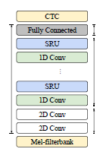
Acoustic modeling
DeepSpeech2 like structure
CNN layers (with time-domain pooling)
RNN layers
Fully connected layer
We add 1-D convolution at the SRU input
The convolution spans in time.
Each convolution does not share the weights
The optimum length is found to be 15
CTC Grapheme (Character) based model
WSJ 284 for fast evaluation
Compare SRU, i-SRU, and LSTM

Slide 24
RNN performances with WSJ Si-284

Slide 25
Past and future context
SRU (or i-SRU) augmented with 1-d conv reduce the WER a lot (greedy decoding: 45% -> 19%)
Augmenting 1-d conv to LSTM does not give much benefit (WER 24.88-> 23.57%)
The effect of observation window for 1-d convolution

Slide 26
Word-piece model
Word-piece model employs the (frequently occurring) words, sub-words, and characters as the labels
The non-blank label generation frequency drops compared to grapheme based AM.
Can operate the AM at a reduced frequency, directly lowering the complexity of AM and LM
No OOV (out of vocabulary problem)
Softmax layer is not as complex as that of word model
Word piece 500, word piece 1000
Training of word piece models needs a lot more acoustic data

Slide 27
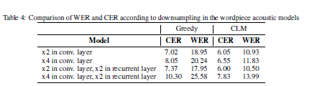
Down sampled word piece models
We can reduce the frame rates by inserting time-domain pooling at the CNN layers or RNN layers

Slide 28
Word piece model performance
Libri speech

Slide 29
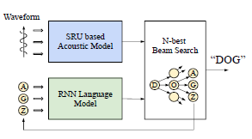
Decoding
Decoding with RNN based CLM (Character-level LM)
Decoding with RNN based hierarchical CLM

Slide 30
Processing time with LM based beam-search decoding

Slide 31
Contents
1. On-device speech recognition and DRAM bandwidth bottleneck problem
2. Muti-time step parallel and linear recurrent RNNs
3. QRNN+1-d time-depth convolution based models
4. Gated ConvNet and Simple Gated ConvNet based models

Slide 32

Gated ConvNet
Dauphin, Yann N., et al. "Language Modeling with Gated Convolutional Networks." International Conference on Machine Learning. 2017.
Multi-layered convolution with Gating mechanism
Gating mechanism controls gradient flows
CNN dose not have recurrent loops
It is suitable for multi-time step parallelization
Notes:
1 분

Slide 33
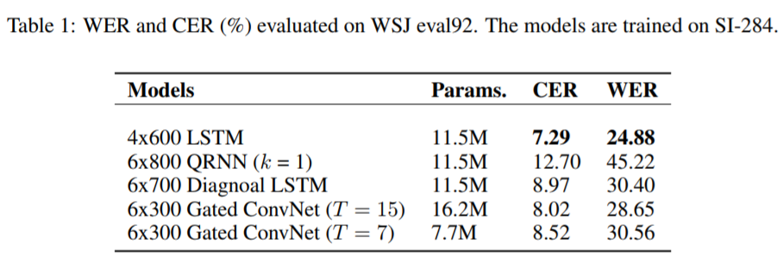
CTC-based models without 1-D convolution
The greedy decoding results are shown below
Gated ConvNet does not show good performance considering the parameter size.
Notes:
1 분

Slide 34
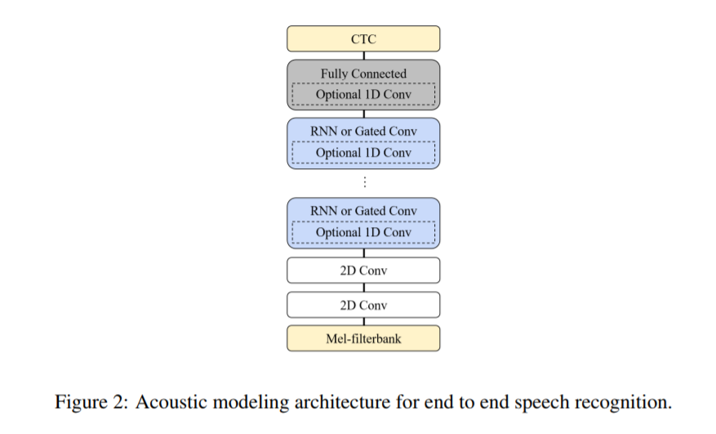
Element-wise 1-D convolution
Instead of using shorter 2-D convolution, we add 1-D time-depth convolution to increase the context length
The size of parameters is very light
Notes:
1 분

Slide 35
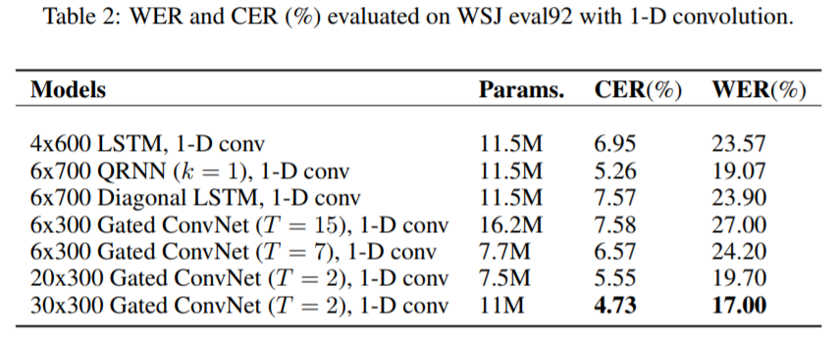
CTC models with 1-D Convolution
With 1-D convolution, on-device friendly models catch up and surpasses the LSTM RNN
Deeper architecture in Gated ConvNet contributes to performance improvements
The greedy decoding results are shown below:
Notes:
1 분

Slide 36
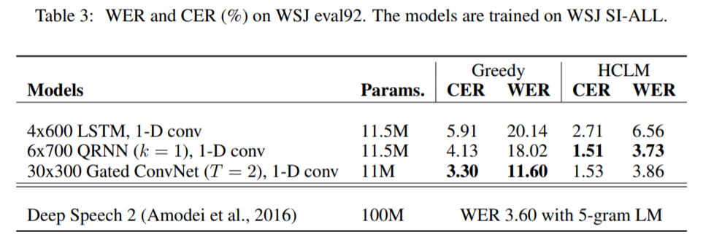
Performance comparison with WSJ SI-All datasets
QRNN and Gated ConvNet show higher performance than LSTM RNN
In Greedy decoding Gated ConvNet with 1-D conv is best, but as the beam-width increases QRNN based one performs better.
Notes:
1 분

Slide 37
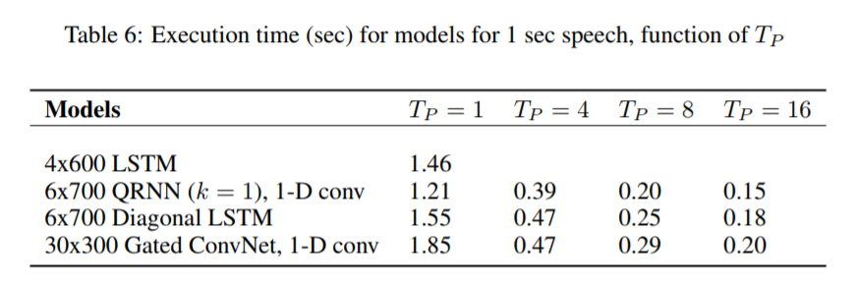
Implementation Results on Embedded Systems
Multi-time step parallelization is performed in on-device friendly models
The QRNN and Gated ConvNet are 7.30 and 5.03 times faster than LSTM when the output for eight timesteps are computed at a time
Notes:
1 분

Slide 38
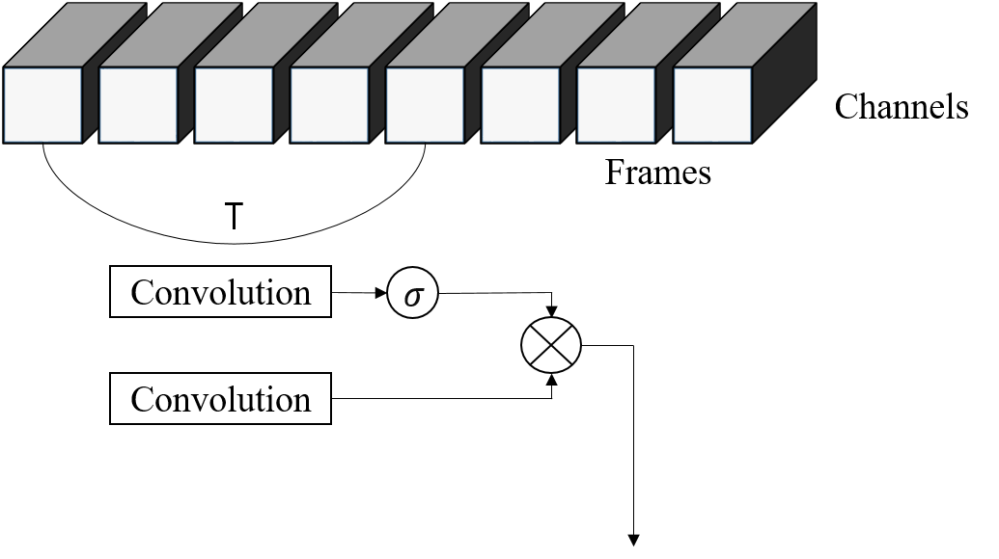
Simple Gated ConvNet for small foot-print end-to-end acoustic modeling
The complexity of Gated ConvNet increases in proportional to T. What if T=1?
The model lacks sequence modeling capability
But, what if we add 1-d convolution

Slide 39
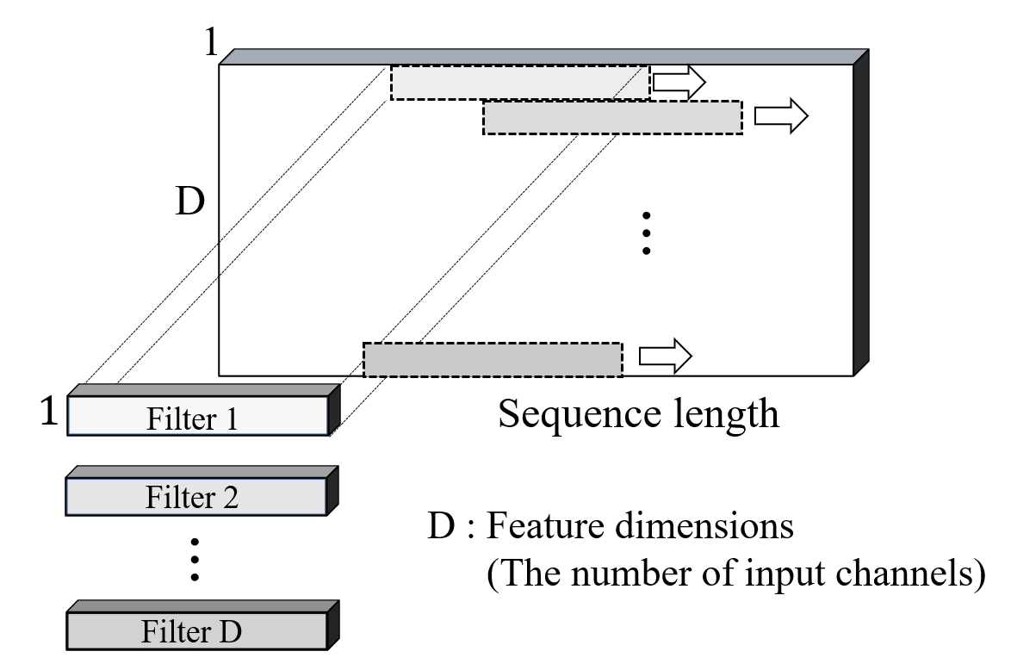
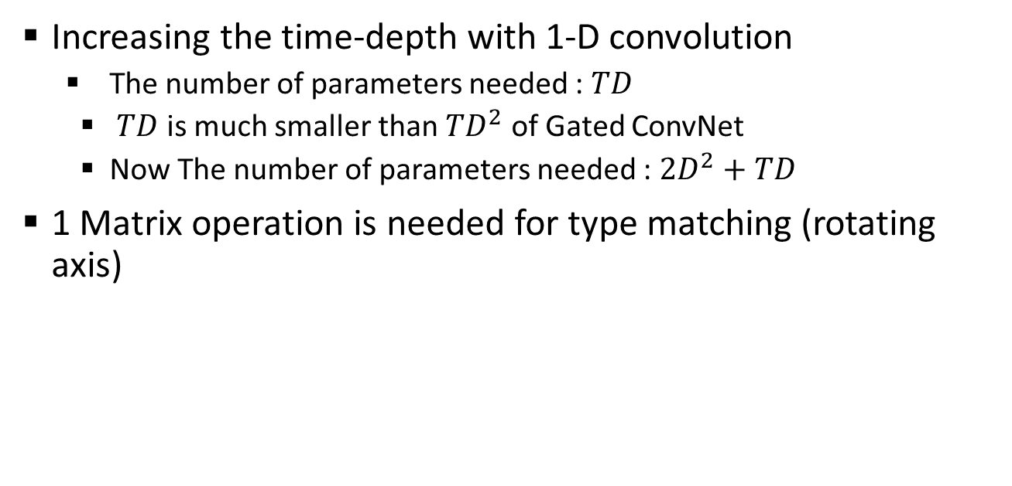
Simple Gated ConvNet: The minimum Gated ConvNet (T=1) + 1-D depthwise convolution
Increasing the time-depth with 1-D convolution
The number of parameters needed : $TD$
$TD$ is much smaller than $TD^{2}$ of Gated ConvNet
Now The number of parameters needed : $2D^{2}+TD$
1 Matrix operation is needed for type matching (rotating axis)
Balduzzi, David, and Muhammad Ghifary.
"Strongly-typed recurrent neural networks."
arXiv preprint arXiv:1602.02218(2016).
Notes:
1 분

Slide 40
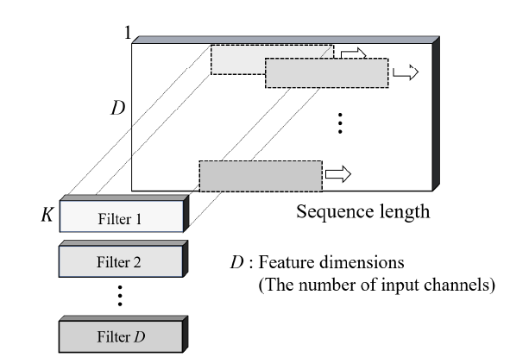

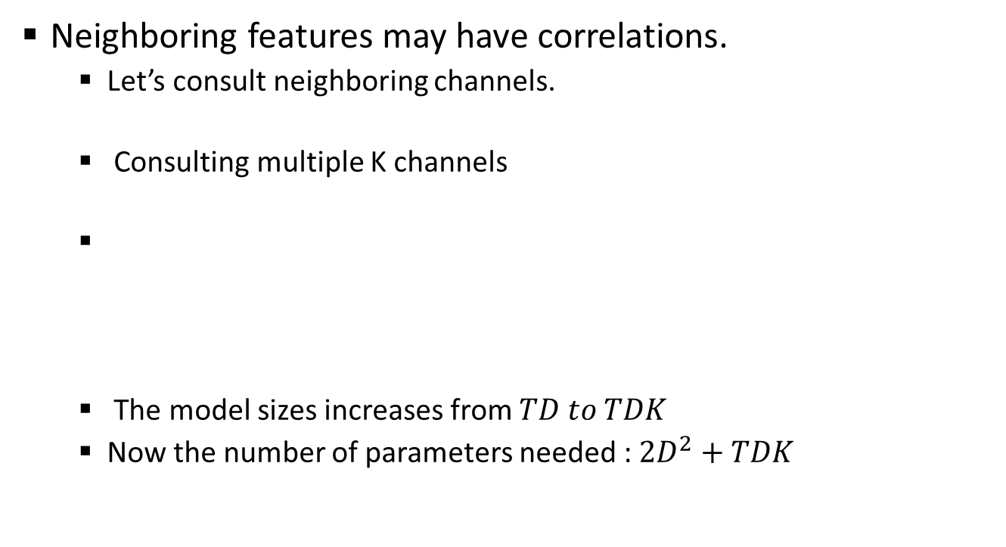
1-D depthwise convolution with the width of K
Neighboring features may have correlations.
Let’s consult neighboring channels.
Consulting multiple K channels
The model sizes increases from $TD to TDK$
Now the number of parameters needed : $2D^{2}+TDK$
Notes:
1 분

Slide 41
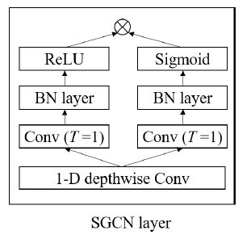
Batch normalization
We employ batch normalization in Simple Gated ConvNet
Batch Normalization was not used in previous Gated ConvNet
But how? Motivated by ResNet (Kaiming He, 2016)
Right after Convolution operations before activations ,
Just add ReLU to the output of
Notes:
1 분

Slide 42
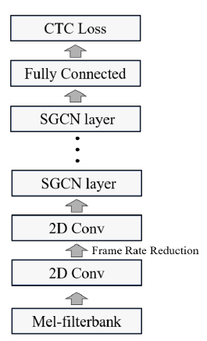
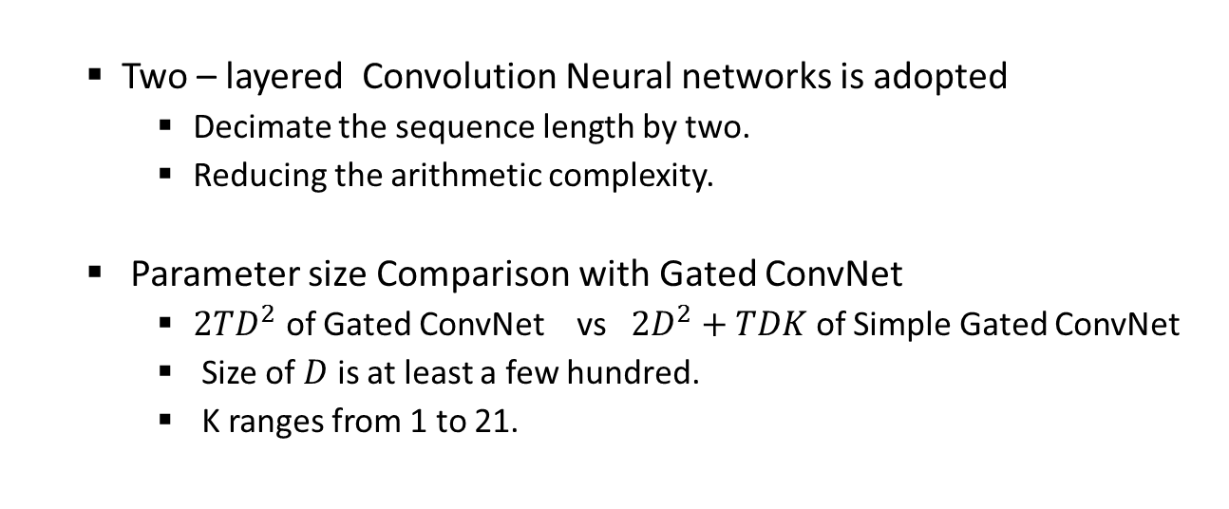
Whole structure of SGCN for end-to-end acoustic modeling
Two – layered Convolution Neural networks is adopted
Decimate the sequence length by two.
Reducing the arithmetic complexity.
Parameter size Comparison with Gated ConvNet
$2TD^{2}$ of Gated ConvNet vs $2D^{2}+TDK$ of Simple Gated ConvNet
Size of $D$ is at least a few hundred.
K ranges from 1 to 21.
Notes:
1 분

Slide 43
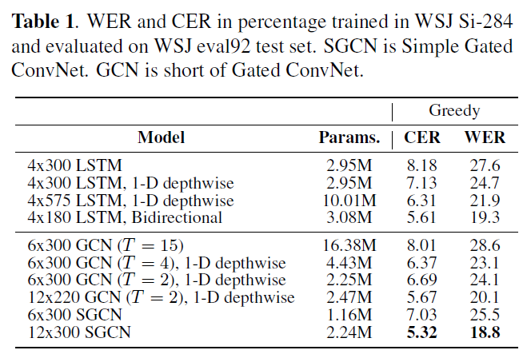
Experimental results: overall performance comparison on WSJ Si-284
SCGN outperforms LSTM RNN
SGCN with 2.24 M > LSTM with 3M
SGCN with 2.24 M > LSTM with 10 M
SGCN > Bidirectional LSTM
SGCN outperforms GCN – Increasing the depth helps
With less number of parameters
Notes:
1 분

Slide 44
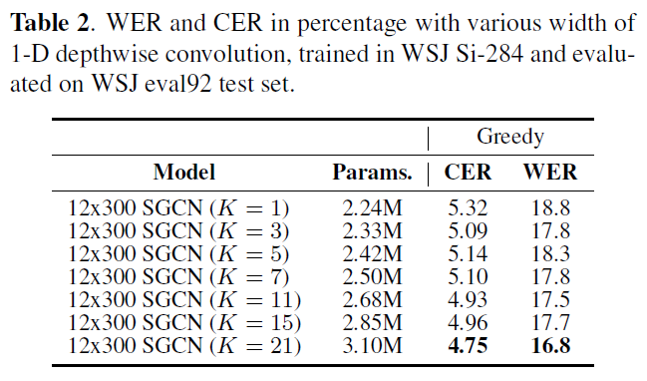
Effect of consulting neighboring channels (K)
Increasing K contributes to performance increase, but shows diminishing return (maybe K=3 would be optimum)
Notes:
1 분

Slide 45
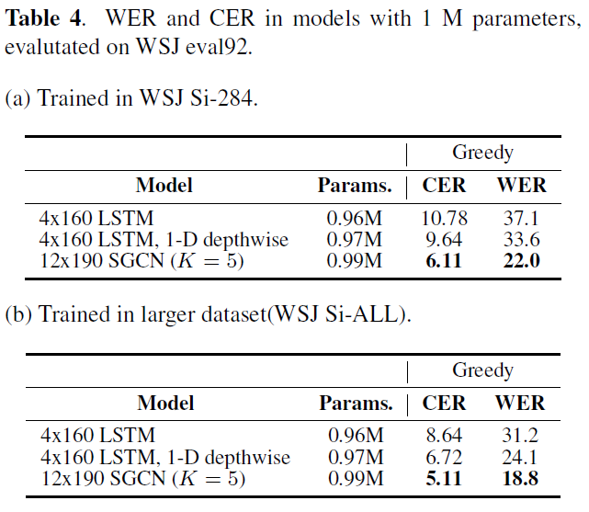
SGCN under 1 M
SGCN shows more Robust performance than LSTM RNN
Notes:
1 분

Slide 46
SGCN for low-latency tasks
When the filter length 𝑇 of 1-D depthwise convolution is 11, and the filter consults the input from t-5, t+5, where t+5 is 5-step futures
One SGCN layer operates with the 20 ms time-steps, and one non-causal layer incurs 100 ms delay ( Considering 5-step futures), the latency hinders real-time speech recognition
In order to eliminate latency, experiments with causal convolution filters were conducted

Slide 47
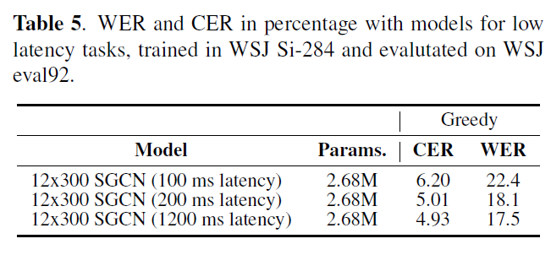
Performance of SGCN under low latency conditions
12-layered Non-causal convolution leads to 1200 ms delay.
Non-causal convolution of only one layer leads to 100 ms
Non-causal convolution of only two layers leads 200 ms
Even with 200 ms latency, it shows affordable performance.

Slide 48
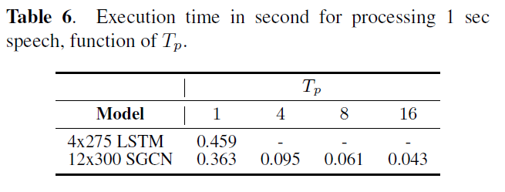
Execution time of multi-time-step SGCN
The implementation results of SGCN on the ARM Cortex-A57.
𝑇_{𝑃} : the number of output samples computed at a time (x10 speed-up compared to the LSTM model)

Slide 49
Other current and future works
Fine-tuning of the models under latency and other decoding condition, especially AutoML will help.
We find that reducing the number of 1-D convolution yields higher accuracy
Experiments on large and real datasets for on-device SR
Application of SRU+1D model to LAS
LAS would be benefit much by using linear RNNs and GCNs
We have not yet obtained very good results
Application of SGCN to keyword spotting
Combination with existing speed-up methods, such as compression and fixed-point optimization.
RNN model compression to very low bits (2bit)

Slide 50
Summary
We explored linear RNN (QRNN, SRU) and Gated ConvNet based models for efficient on-device acoustic modeling. These models support multi-time-step parallel execution and show 3~8 times of speedup on embedded devices
We can increase the performance of QRNN and Gated ConvNet based models by augmenting 1-d convolution at each layer
Especially, SGCN showed good performance in low foot-print setting (1Million or around).

Slide 51
Publications related to today’s talk
Fully Neural Network Based Speech Recognition on Mobile and Embedded Devices, J Park, Y Boo, I Choi, S Shin, W Sung, Advances in Neural Information Processing Systems, 2018
SIMPLE GATED CONVNET FOR SMALL FOOTPRINT ACOUSTIC MODELING' submitted to the ICASSP 2019

